Slide 1
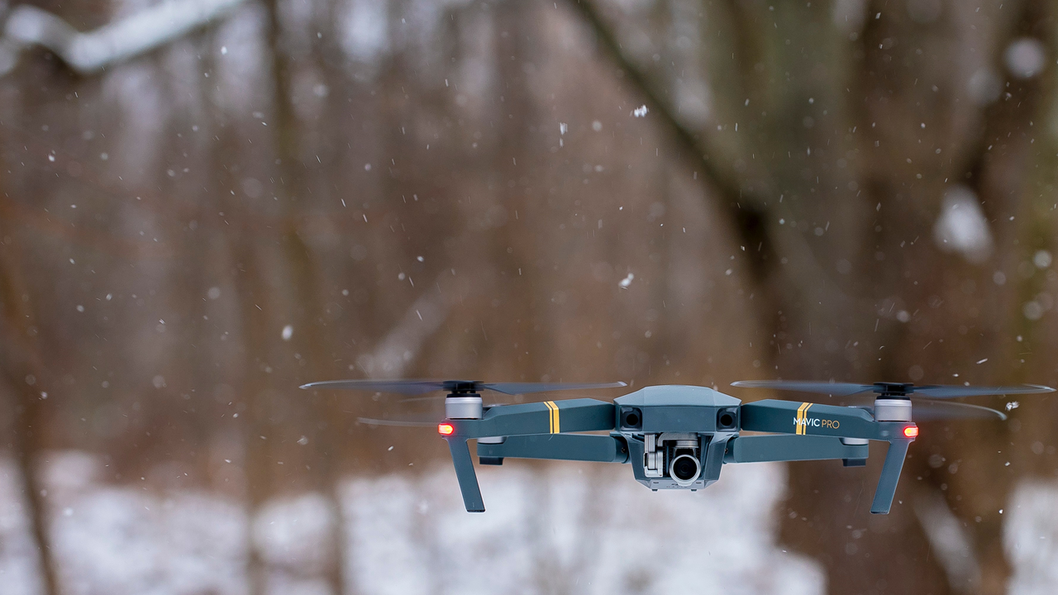
Drone Localization in Ad-hoc Indoor Environment
Marcell Rausch
2020.06.23

Slide 2
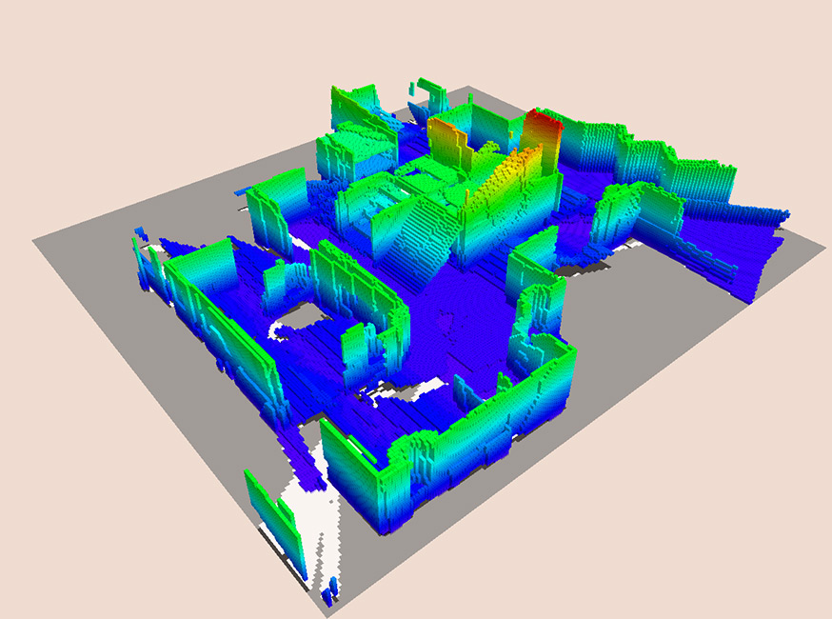
Task
The student’s task is to develop a positioning system by placing stationary LIDAR sensors on a drone, to collect range measurements of its environment and use a SLAM algorithm to find the current position. The position and orientation of these sensors is fixed relative to the drone’s frame and scanning of the drone’s environment is done by orientation changes that happen due to the natural motion during flights.

Slide 3
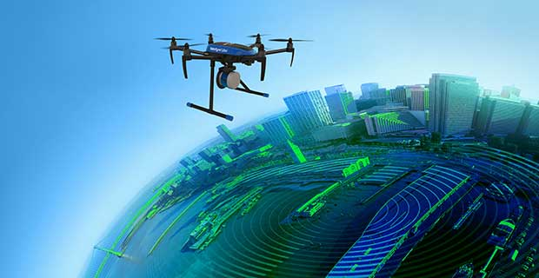
Motivation
Typically used sensors for mapping and localization
Planar scanners - LIDAR
Accurate
Too heavy for small vehicles
Sensitive
Expensive
Monocular, stereo or RGB-D camera
Detailed maps
Produces high amounts of data
High computation needs

Slide 4
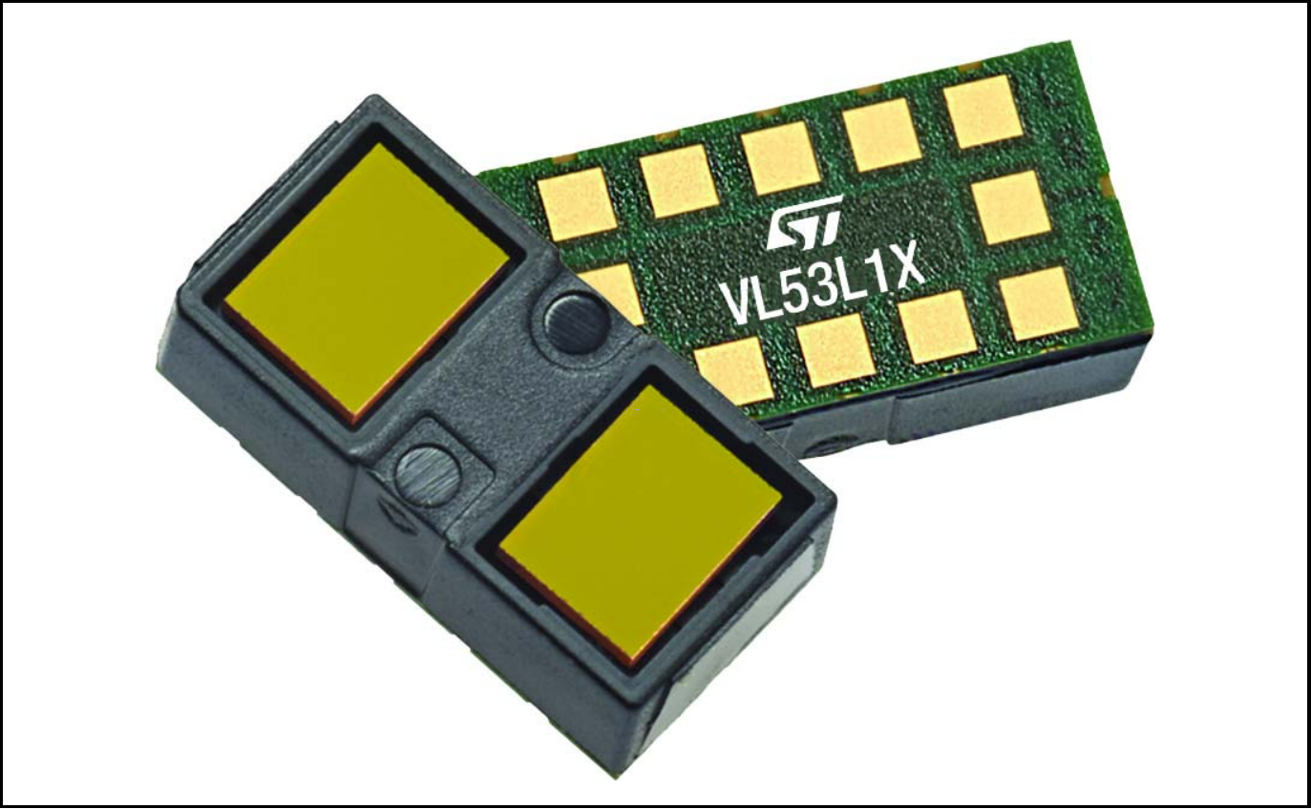
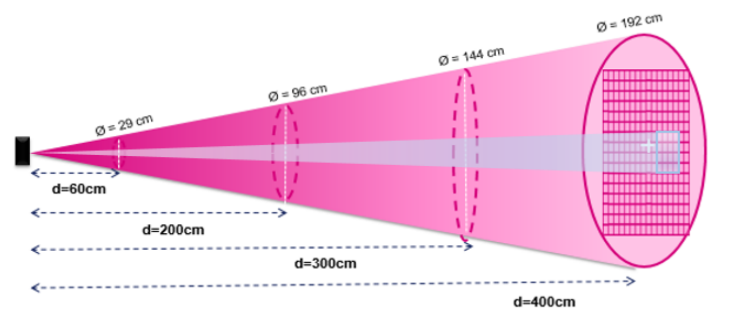
VL53L1X LIDAR
4m maximum range
50Hz maximum sampling rage
Small size: 4.9x2.5x1.56mm
27° Field of view
Adjustable Region of Interest

Slide 5
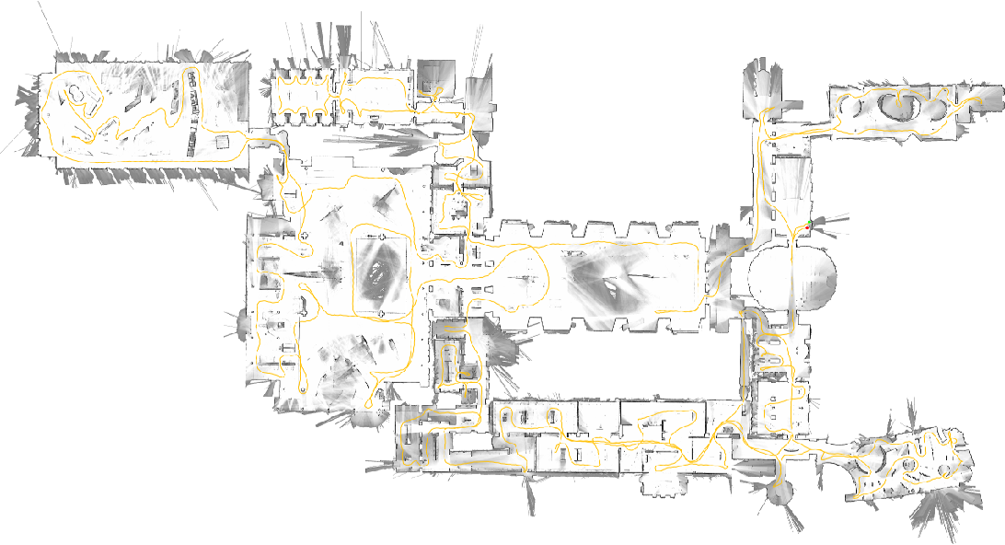
Google Cartographer SLAM
Inputs: LIDAR scan and IMU
2D and 3D online SLAM
Used by Google street view
Great community
Available as ROS package

Slide 6
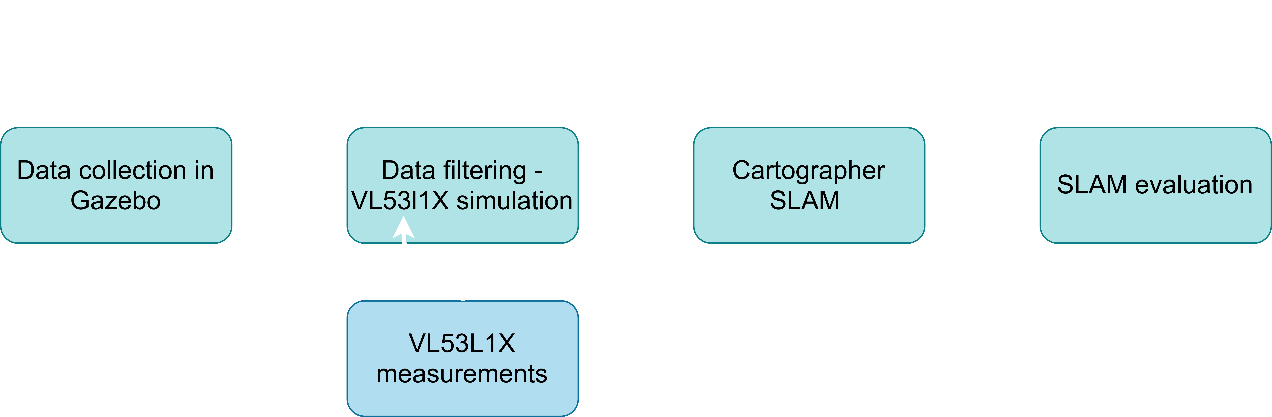
System design overview

Slide 7
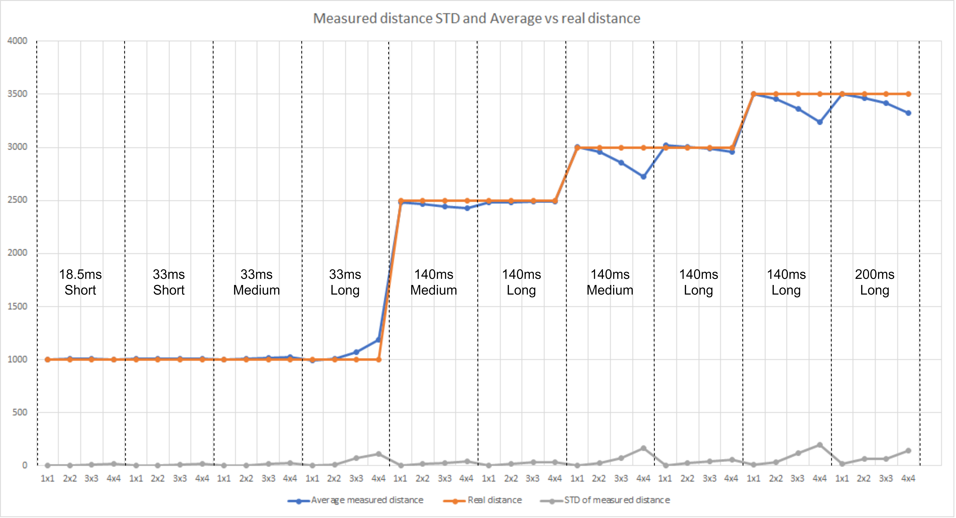
VL53L1X measurements
Sensor settings
Distance preset: Short, Medium, Long
Timing budget: 18.5ms, 33ms, 140ms, 200ms
Resolution by moving RoI: 1x1, 2x2, 3x3, 4x4

Slide 8
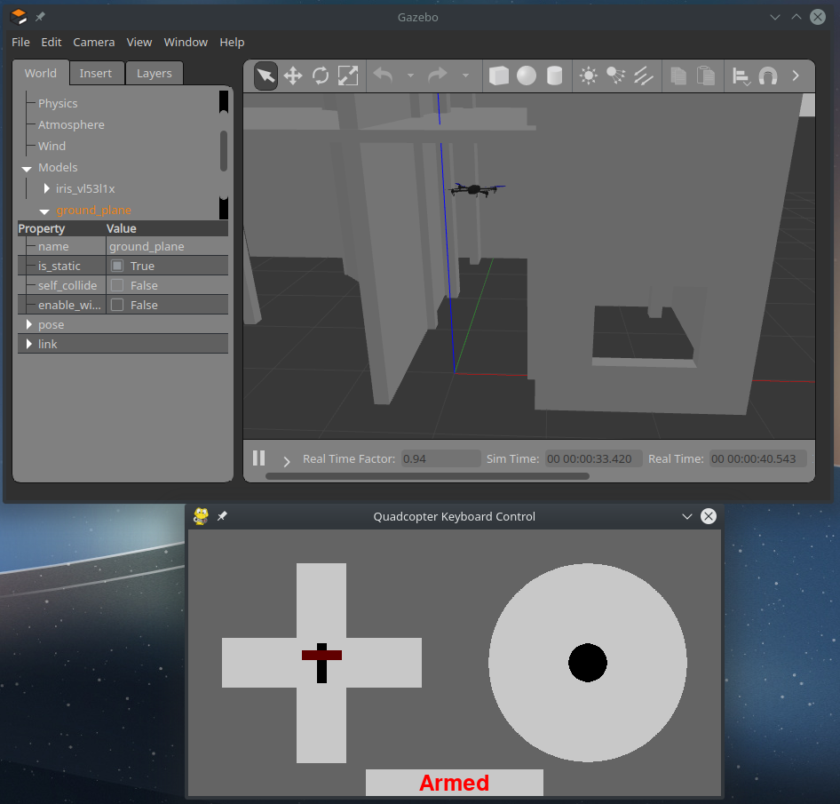
VL53L1X simulation
1. Data collection
Gazebo Simulator using ROS
Iris drone using PX4 Repository
360° LIDAR data
Recorded into Rosbag
2. Data filtering
Python script
Converts raw LIDAR data to simulate VL53L1X sensors
FoV, update rate, max distance
Layout

Slide 9
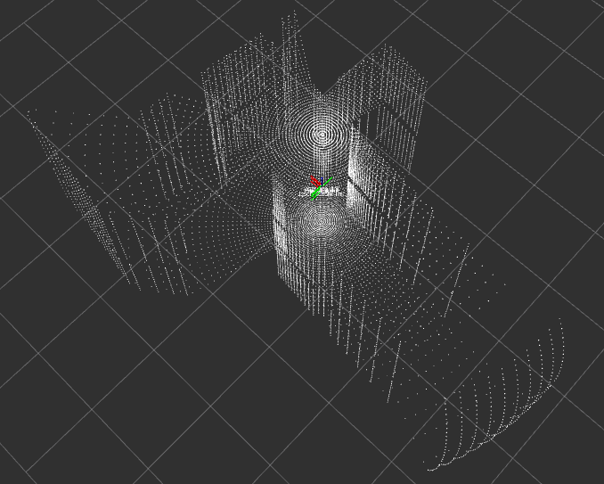
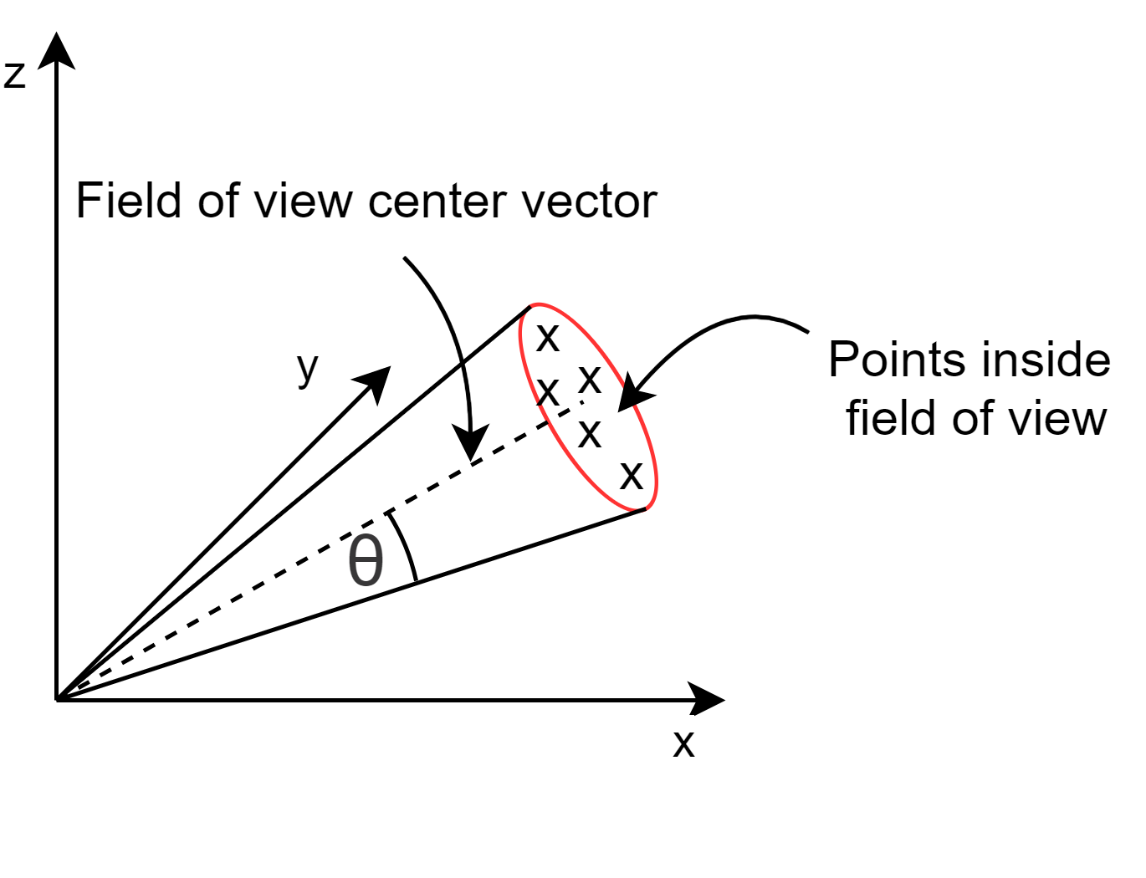
VL53L1X simulation
1. Data collection
Gazebo Simulator using ROS
Iris drone using PX4 Repository
360° LIDAR data
Recorded into Rosbag
2. Data filtering
Python script
Converts raw LIDAR data to simulate VL53L1X sensors
FoV, update rate, max distance
Layout

Slide 10
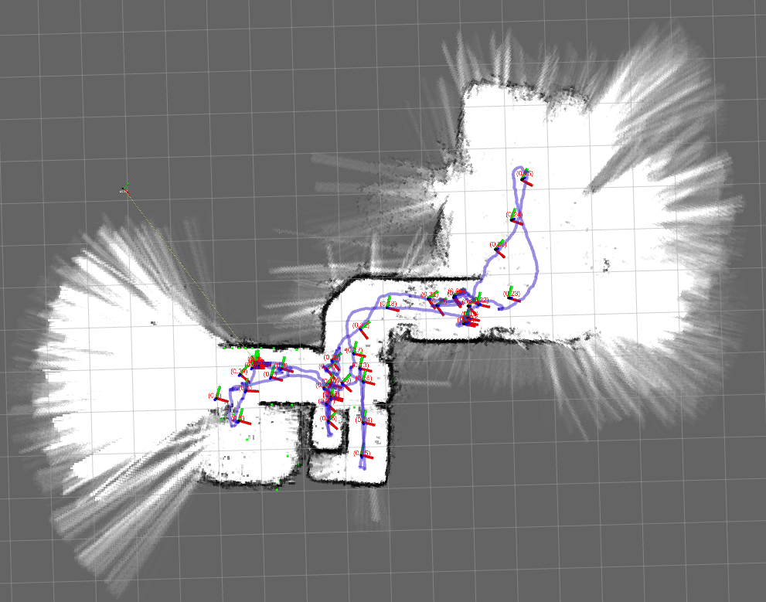
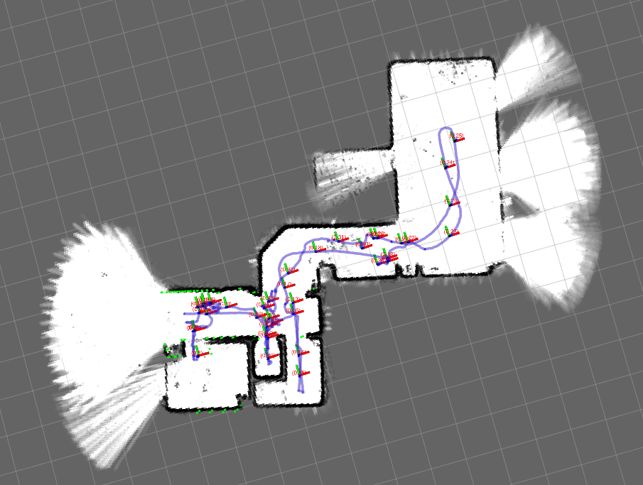
Cartographer tuning
Complex process
Requires good understanding of parameters
Each setup requires different tuning
*Illustration

Slide 11
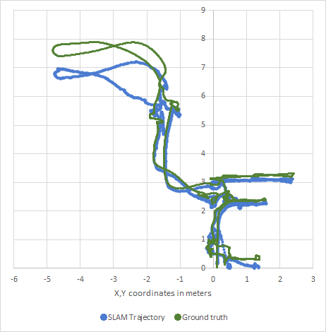
SLAM setup evaluation
1.Visual inspection of produced map
Submap quality and reliability
Global map quality and reliability
2. RMS error calculation of SLAM trajectory
Against ground truth trajectory
Objective measure

Slide 12
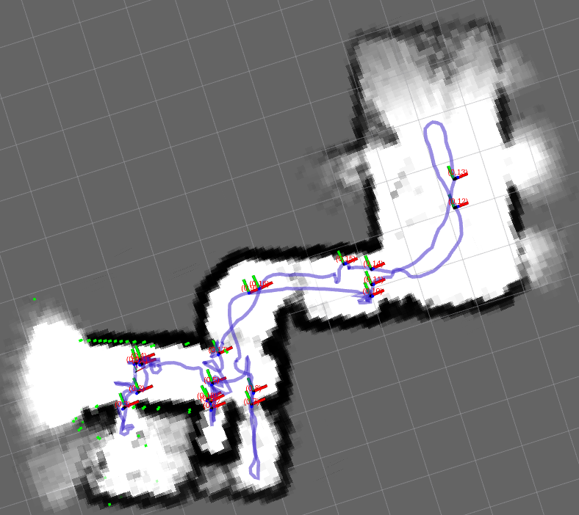
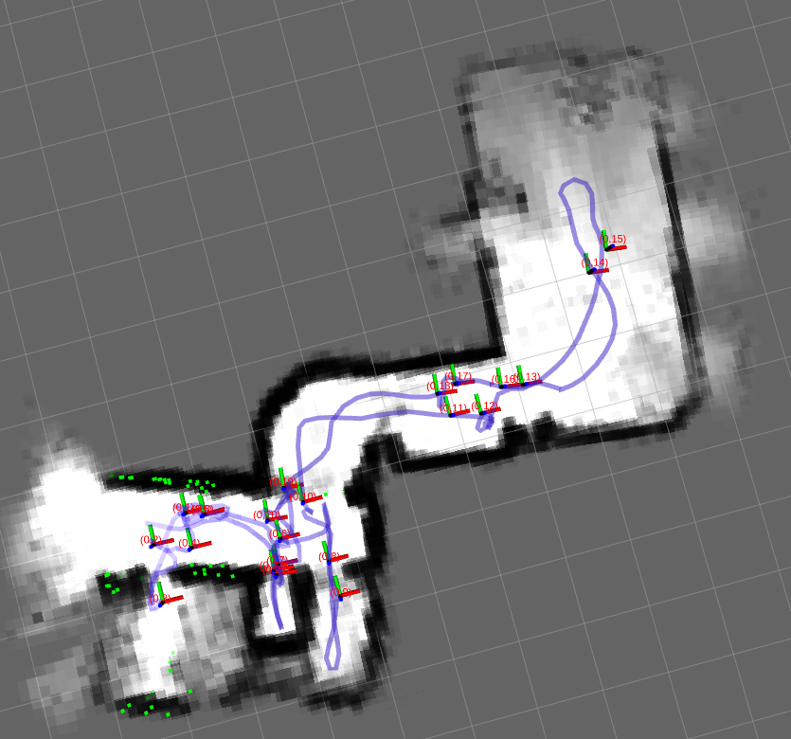
2D SLAM Results
13 sensors
13 LIDARs to cover the 360° horizontal plane
Introduced sensor parameters one by one
4x4 and 3x3 resolution has similar performance
33ms timing budget and Long preset
Maximum distance is crucial
Reduced the number of sensors until map building is reliable
8 sensors proved to be the lowest number that is able to produce reliable maps
8 sensors

Slide 13
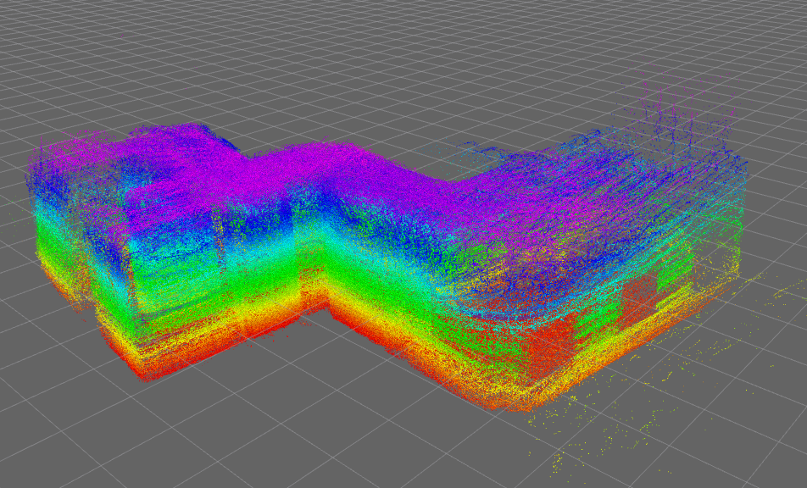
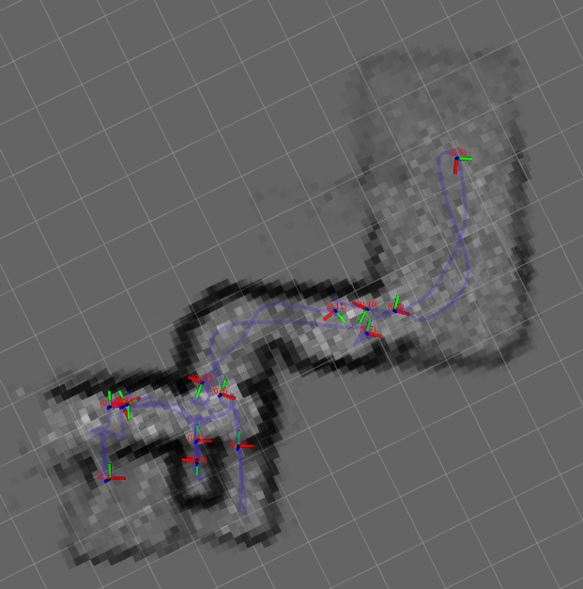
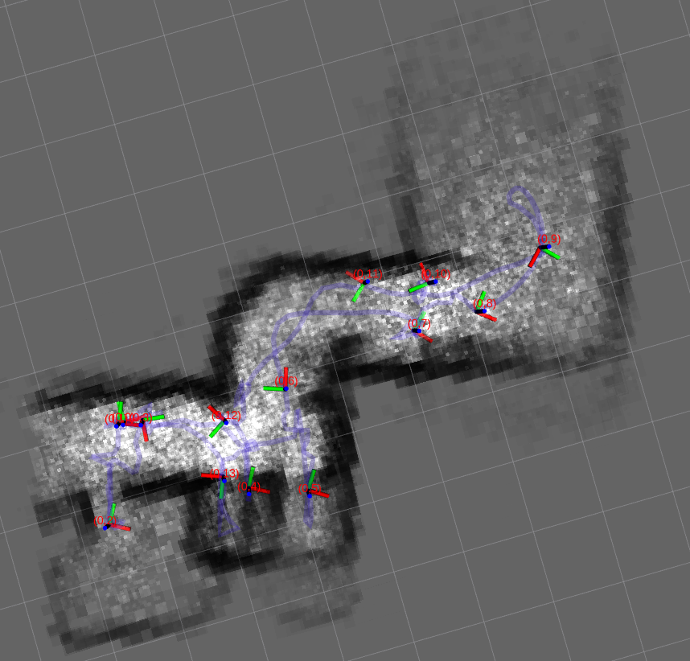
3D SLAM Results
43 LIDARs to cover the drone’s surroundings in 3D
Introduced sensor parameters one by one
The introduction of the last parameter maximum distance made the map building unreliable
3D SLAM is not reliable with 43 sensors so it is safe to assume it will not work with less
4x4, 33ms, 4m
4x4, 33ms,
2.75m

Slide 14
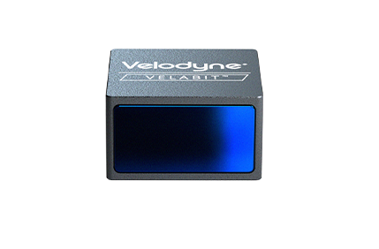
Summary & Future work
Summary
2D SLAM works reliably using 8 sensors
Requires tuning in different scenarios
Maximum indoor distance 2.75m
3D SLAM is unreliable even with 43 sensors
Still possible by using 2D SLAM and combine it with height information from another source
Future work
Velodyne Velabit LIDAR

Slide 15
Bíráló kérdései
A drón maximális sebességét említette a kivonatban, azonban a dolgozatban nem tért ki rá részletesen, hogy miért 5 km/h lehet a maximuma, ami még nem befolyásolja nagyon negatívan a lokalizáció pontosságát?
Ön szerint a LIDAR es kamera szenzorok kombinációjával javítható lenne a pontosság?
Ön szerint milyen hatása lenne, ha a szenzor adatokat egy vezetéknélküli hálózaton kellene valós időben átküldeni, ahol pl. csomagvesztés és késleltetésingadozás léphet fel?

Slide 16
Thank you for your attention!

